Slide 1




On Skyline Groups
Chengkai Li
Naeemul Hassan
Gautam Das
University of Texas at Arlington
Nan Zhang
Sundaresan Rajasekaran
George Washington University

Slide 2
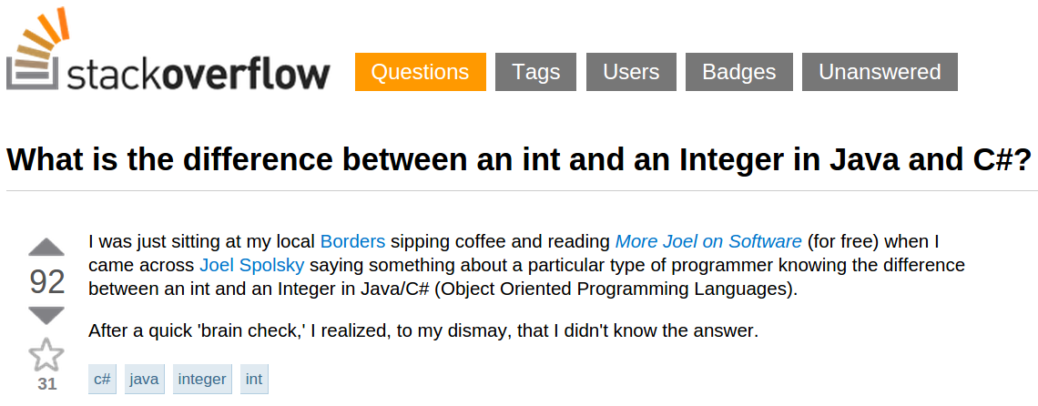
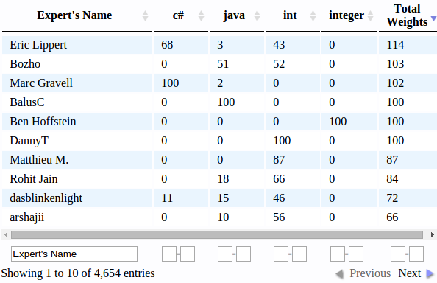
Motivation
Question-Answer Platforms
Question
Skills
Goal: Find a group of experts who can answer this question
1
Notes:
I will talk more about motivation; giving you ideas where it has potential.
How many of you haven’t heard of StackOverflow? Explain if there is any.
Problem of current answer approach.
Answers touching all the required skills are better.

Slide 3
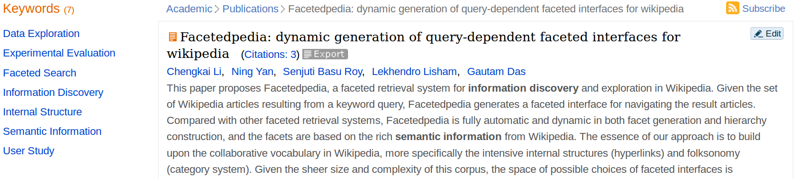
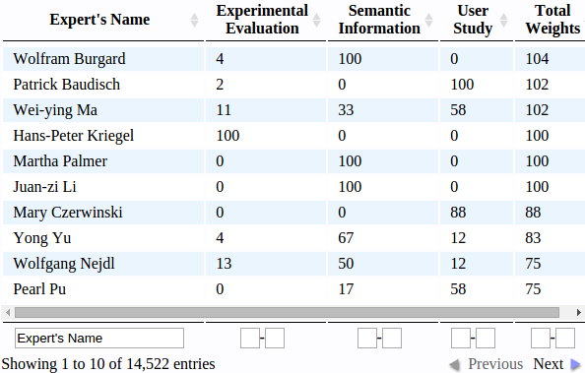
Motivation
Journal/Paper Review
Task
Skills
Goal: Find a group of experts who can review this paper
2

Slide 4
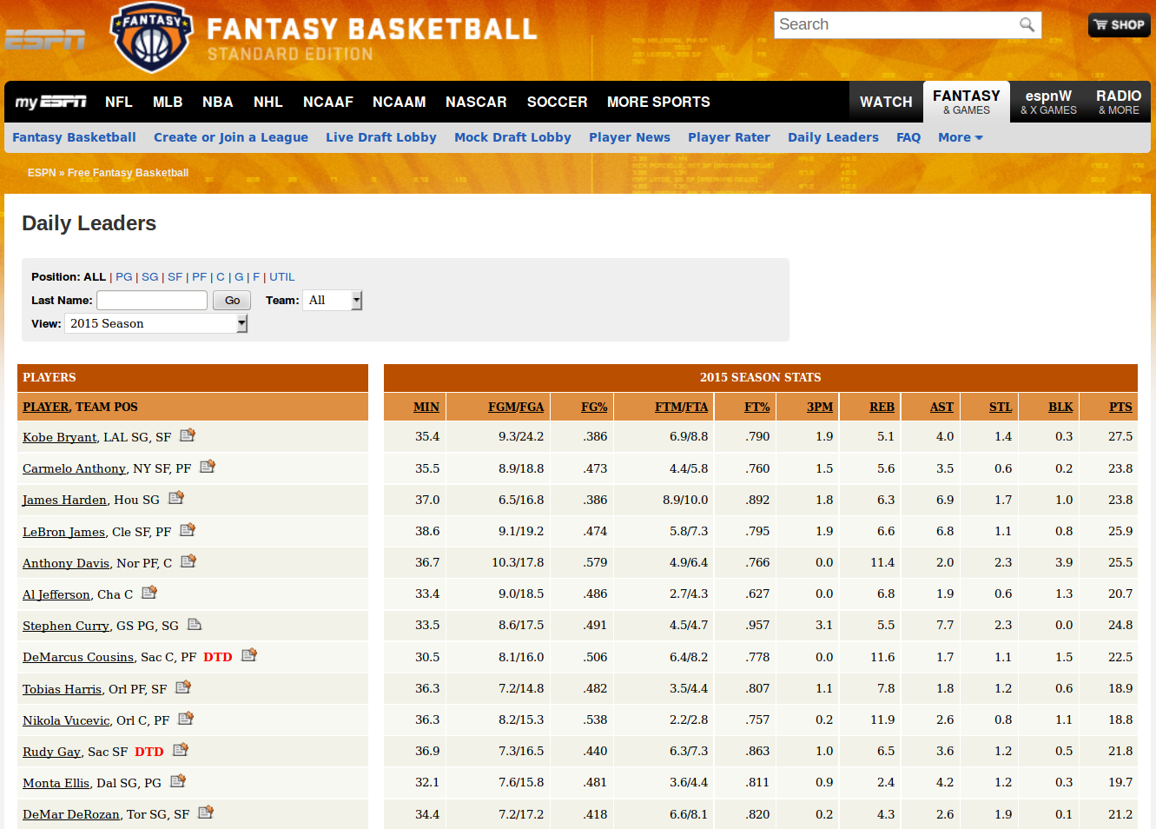
Motivation
Fantasy Games
Skills
Goal: Find a group of players for Fantasy Basketball
3
Notes:
You can imagine Fantasy Cricket if you like.
Many Applications; basically wherever we need a group of experts.

Slide 5
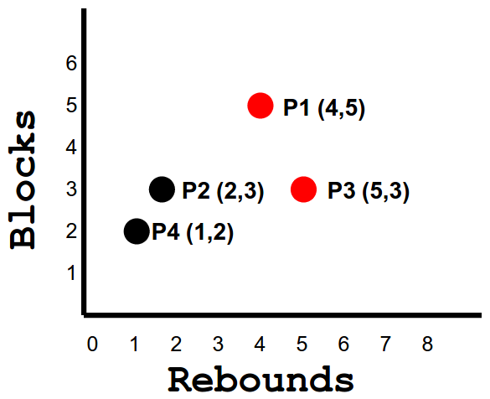
Problem Definition
What is Skyline?
NBA Players Score
 | Rebounds | Blocks
P1 | 4 | 5
P2 | 2 | 3
P3 | 5 | 3
P4 | 1 | 2
P5 | 1 | 2
Skyline tuple: A tuple which is not dominated by any other tuple.
4
Notes:
Explain skyline first.
Explain with one column, then two columns.

Slide 6
Problem Definition
What is Skyline Group?
NBA Players Score
 | SUM |  |  | MIN |  |  | MAX
 | P | R | B | P | R | B | P | R | B
P1, P2, P3 | 11 | 11 | 11 | 3 | 2 | 3 | 4 | 5 | 5
P1, P2, P4 | 9 | 7 | 10 | 2 | 1 | 2 | 4 | 4 | 5
P1, P2, P5 | 11 | 7 | 10 | 3 | 1 | 2 | 4 | 4 | 5
P1, P3, P4 | 9 | 10 | 10 | 2 | 1 | 2 | 4 | 5 | 5
P1, P3, P5 | 11 | 10 | 10 | 3 | 1 | 2 | 4 | 5 | 5
P1, P4, P5 | 9 | 6 | 9 | 2 | 1 | 2 | 4 | 4 | 5
P2, P3, P4 | 10 | 8 | 8 | 2 | 1 | 2 | 4 | 5 | 3
P2, P3, P5 | 12 | 8 | 8 | 4 | 1 | 2 | 4 | 5 | 3
P2, P4, P5 | 10 | 4 | 7 | 2 | 1 | 2 | 4 | 2 | 3
P3, P4, P5 | 10 | 7 | 7 | 2 | 1 | 2 | 4 | 5 | 3
 | Points | Rebounds | Blocks
P1 | 3 | 4 | 5
P2 | 4 | 2 | 3
P3 | 4 | 5 | 3
P4 | 2 | 1 | 2
P5 | 4 | 1 | 2
Skyline Players
Skyline Groups
Find a group of 3 players
5 Choose 3 = 10 possible groups
5
Notes:
Explain skyline first.

Slide 7
Problem Definition
Why Skyline Group?
NBA Players Score
 | SUM |  |  | MIN |  |  | MAX
 | P | R | B | P | R | B | P | R | B
P1, P2, P3 | 11 | 11 | 11 | 3 | 2 | 3 | 4 | 5 | 5
P1, P2, P4 | 9 | 7 | 10 | 2 | 1 | 2 | 4 | 4 | 5
P1, P2, P5 | 11 | 7 | 10 | 3 | 1 | 2 | 4 | 4 | 5
P1, P3, P4 | 9 | 10 | 10 | 2 | 1 | 2 | 4 | 5 | 5
P1, P3, P5 | 11 | 10 | 10 | 3 | 1 | 2 | 4 | 5 | 5
P1, P4, P5 | 9 | 6 | 9 | 2 | 1 | 2 | 4 | 4 | 5
P2, P3, P4 | 10 | 8 | 8 | 2 | 1 | 2 | 4 | 5 | 3
P2, P3, P5 | 12 | 8 | 8 | 4 | 1 | 2 | 4 | 5 | 3
P2, P4, P5 | 10 | 4 | 7 | 2 | 1 | 2 | 4 | 2 | 3
P3, P4, P5 | 10 | 7 | 7 | 2 | 1 | 2 | 4 | 5 | 3
 | Points | Rebounds | Blocks
P1 | 3 | 4 | 5
P2 | 4 | 2 | 3
P3 | 4 | 5 | 3
P4 | 2 | 1 | 2
P5 | 4 | 1 | 2
What’s wrong with taking most expert in each field?
Any other group is dominated by a Skyline
6
Notes:
323 212 312 212 412

Slide 8

Solution Framework
Baseline Method
Input
n players/tuples
group size k
aggregate function
(sum/min/max)
group generation
(SUM / MIN / MAX)
skyline operation
n, k
all skyline groups
Problems
Exponential group generation. We may not afford to compute or store them.
Example: For n = 2000, k = 3.
1331334000 groups
30 GB space [assuming 24B for each group]
15 days time [assuming 1 millisecond for each group]
7

Slide 9
Solution Framework
Advanced Method: WCM
Weak Candidate Generation Property: If G is a k tuple skyline group, then there is at least one (k-1) tuple subset of G such that it is a (k-1) tuple skyline group.
Example:
P1, P2, P3
3 tuple skyline group
P2, P3
P1, P2
P1, P3
At least one of them is a 2 tuple skyline group
Does this property sound familiar?
Aprioi Principle: If an itemset is frequent, then all of its subsets must also be frequent
8

Slide 10
Comparison Between
Apriori & WCM Property
null
A
B
C
D
Non-Frequent Itemset
BC
AD
AB
AC
BD
CD
ABC
ABD
BCD
ACD
null
ABCD
A
B
C
D
Non 2 tuple
Skyline Group
Apriori Principle
AB
AC
BC
AD
BD
CD
ABC
ABD
BCD
ACD
WCM has less pruning power than Apriori
ABCD
WCM Property
9

Slide 11
WCM Algorithm
Input: n tuples, group size k, aggregate function = min/max (not sum)
Let, i = 1
Generate 1 tuple Candidate groups, C1 = all n tuples
Generate 1 tuple Skyline groups, S1 = skyline_operation(C1)
for i = 2 to k
Generate i tuple Candidate groups, Ci from Si-1
Generate i tuple Skyline groups, Si = skyline_operation(Ci)
Return Sk
10

Slide 12
WCM Algorithm
Explained with Example
Input: n tuple {P1, P2, P3, P4, P5}, group size k = 3, aggregate function = min
 | P | R | B
P1 | 3 | 4 | 5
P2 | 4 | 2 | 3
P3 | 4 | 5 | 3
P4 | 2 | 1 | 2
P5 | 4 | 1 | 2
 | P | R | B
P1 | 3 | 4 | 5
P3 | 4 | 5 | 3
 | P | R | B
P1,P2 | 3 | 2 | 3
P1,P3 | 3 | 4 | 3
P1,P4 | 2 | 1 | 2
P1,P5 | 3 | 1 | 2
P3,P2 | 4 | 2 | 3
P3,P4 | 2 | 1 | 2
P3,P5 | 4 | 1 | 2
 | P | R | B
P1,P3 | 3 | 4 | 3
P3,P2 | 4 | 2 | 3
S1
S2
Note that, (P2,P4), (P2,P5) and (P4,P5) are not generated in C2.
 | P | R | B
P1,P3,P2 | 3 | 2 | 3
P1,P3,P4 | 2 | 1 | 2
P1,P3,P5 | 3 | 1 | 2
P3,P2,P4 | 2 | 1 | 2
P3,P2,P5 | 4 | 1 | 2
C1
 | P | R | B
P1,P3,P2 | 3 | 2 | 3
P3,P2,P5 | 4 | 1 | 2
C2
S3
C3
11
Notes:
323 212 312 212 412

Slide 13
Question
?
12
Notes:
OK. I have one question for you. Where else can we apply this technique?

Slide 14
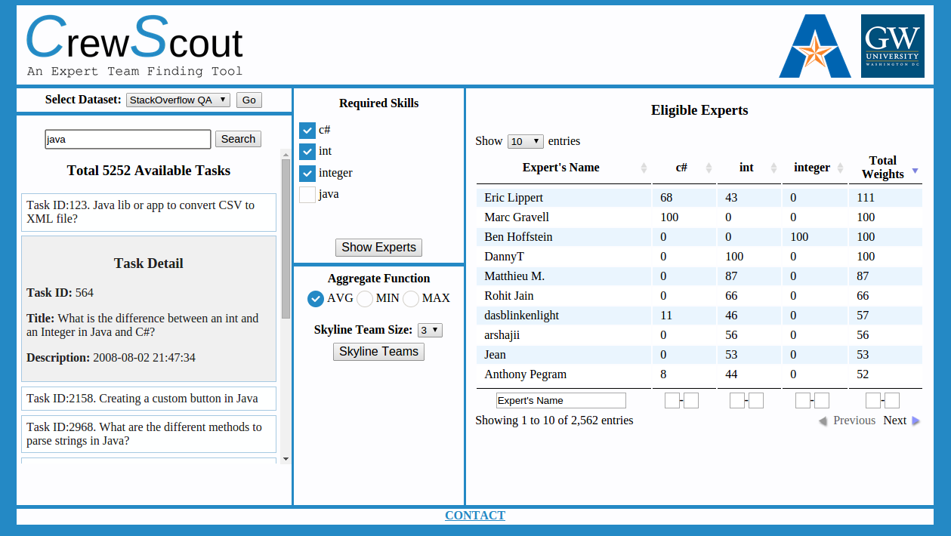
CrewScout System
http://idir.uta.edu/crewscout
13

Slide 15
Thank You!

